Slide 1
Machine Learning and Financial Applications
Lecture 10
Black Litterman Model
Liu Peng
liupeng@smu.edu.sg

Slide 2



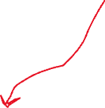
When estimates go wrong
ML
What is the impact?
How to reduce the impact?
plug in
obj: max_w (w^T \hat{mu} – lambda/2 * w^T \hat{sigma} w)
w* is less sensitive to {\hat{mu}, \hat{sigma}}
e.g. t: (0.8, 0.2) → t+1: (0.2, 0.8)

Slide 3



Black-Litterman Model
An advanced portfolio allocation framework that combines the Capital Asset Pricing Model (CAPM) equilibrium with investor-specific views to derive a set of optimal asset allocations.
Addresses the limitations of traditional mean-variance optimization by providing more stable and intuitive portfolio weights.
CAPM serves as the parameters of a prior distribution (assumed to be normal), and investor views as observed data.
Jointly, they form a posterior distribution on expected returns
data
prob
prior
+ data → posterior
setup
w*
w

Slide 4
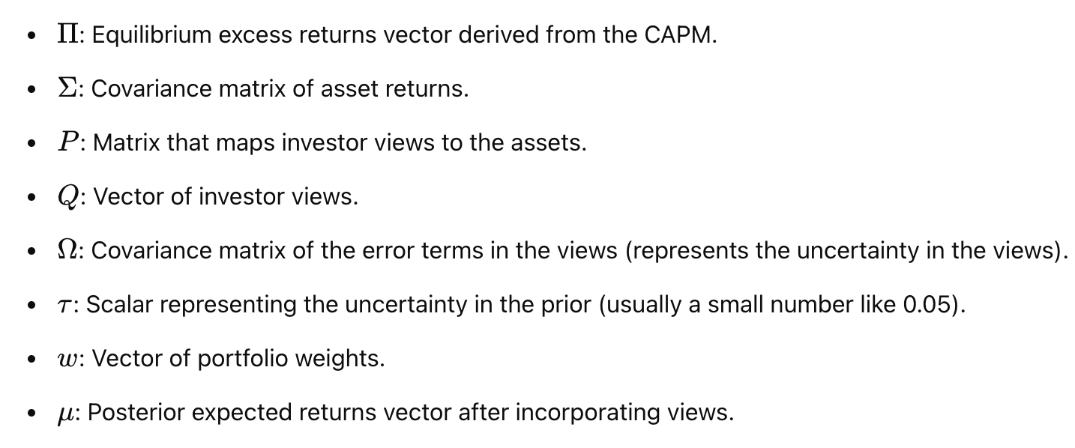
Key Components and Notations

Slide 5
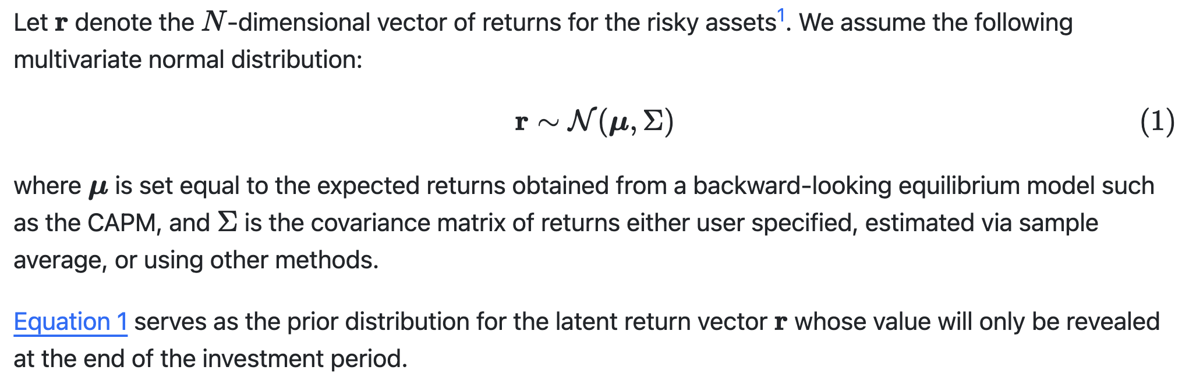
Equilibrium Model and Prior Distribution for Returns

Slide 6
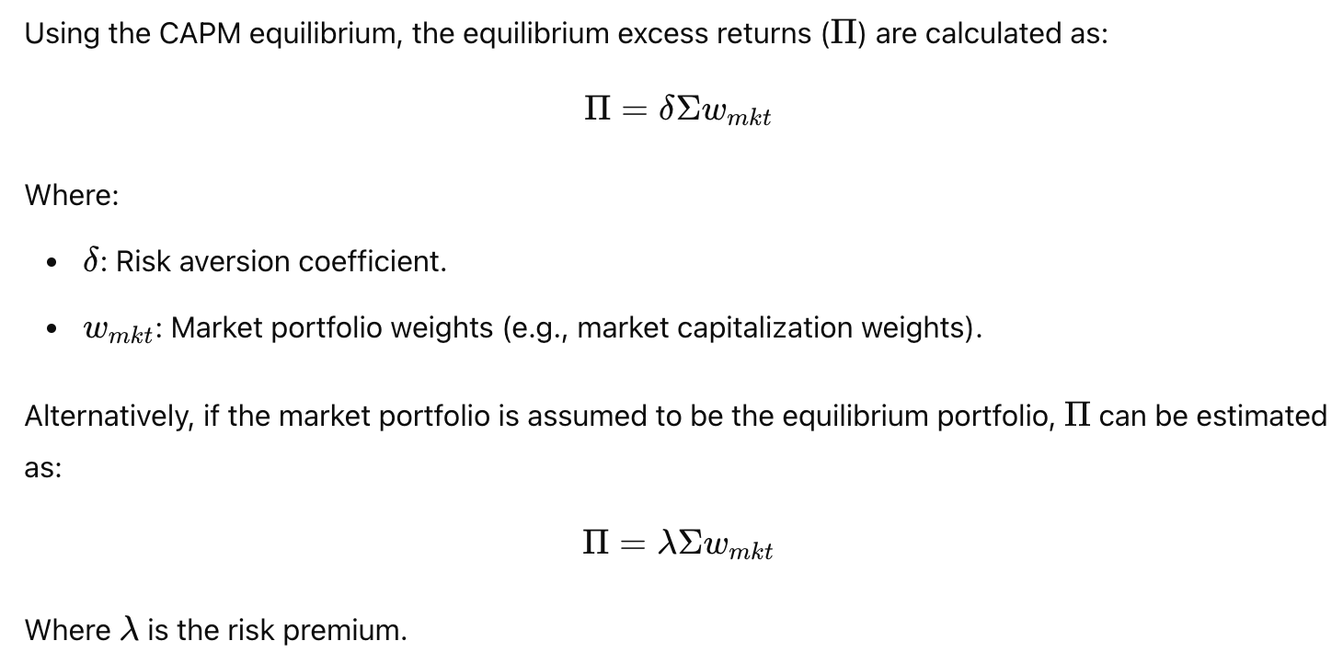
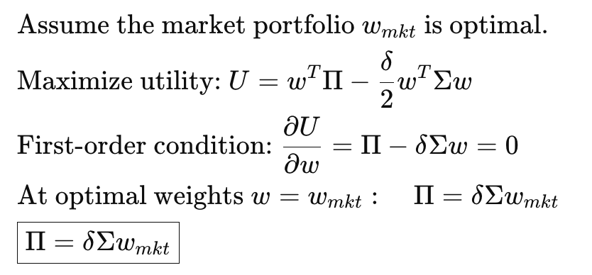

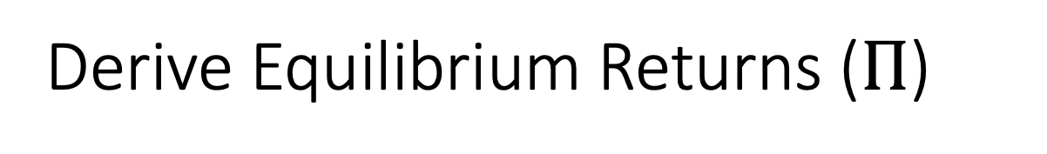
Derive Equilibrium Returns ($Π$)
(optional)
inverse opt: w* → \hat{mu}
\hat{w}, \hat{sigma} → w*

Slide 7
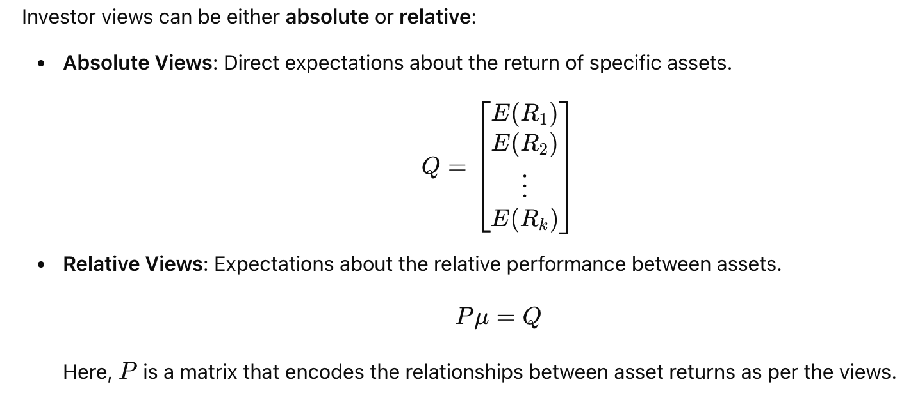
Specify Investor Views

Slide 8
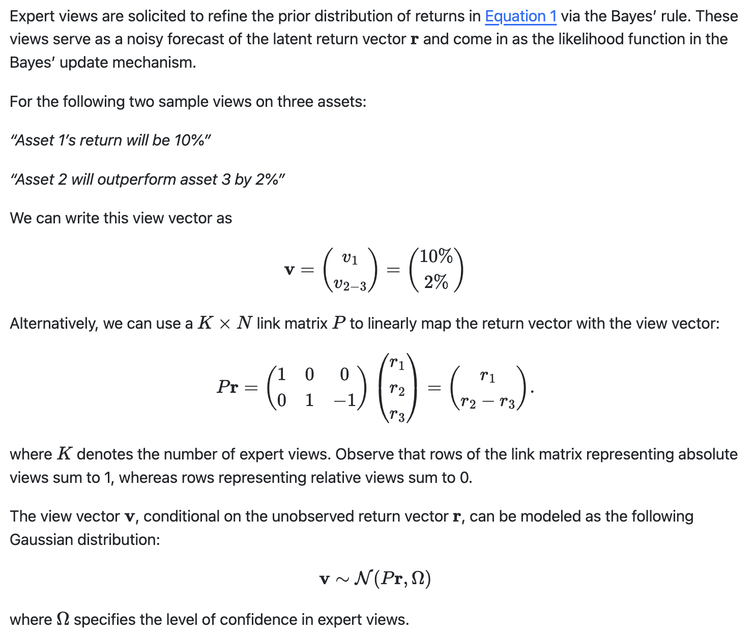
Investor Views Representation
sigma

Slide 9
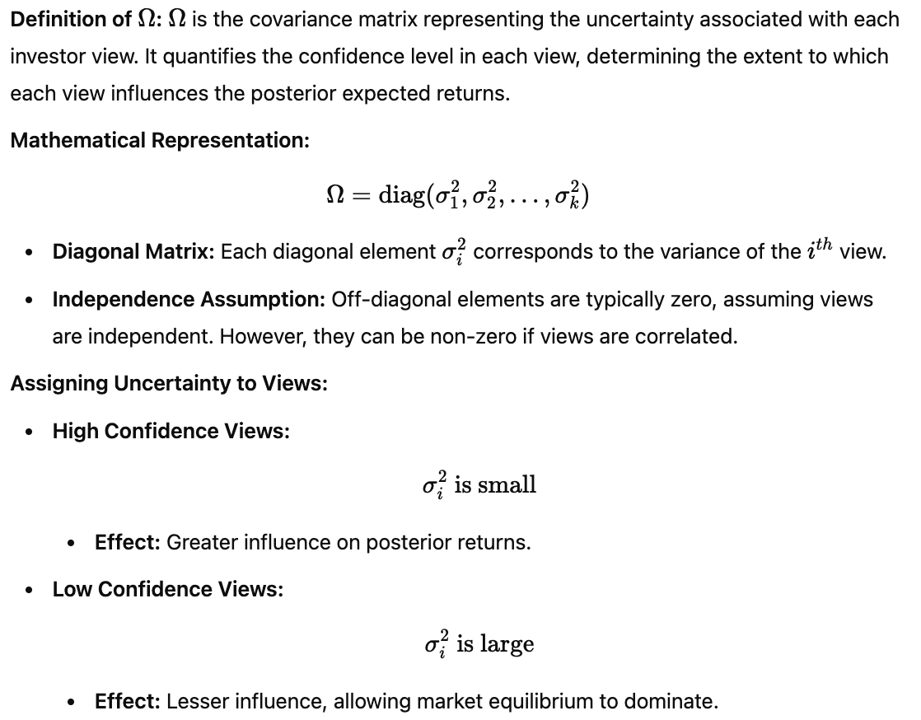
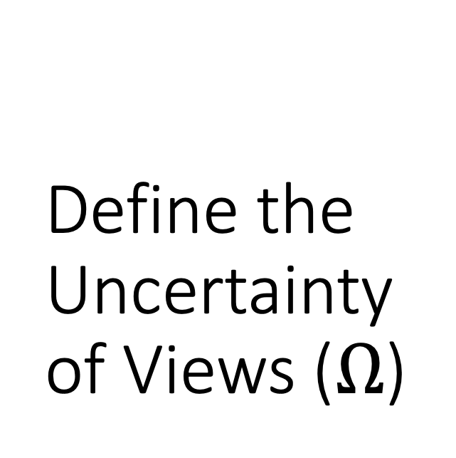
Define the Uncertainty of Views ($Ω$)

Slide 10
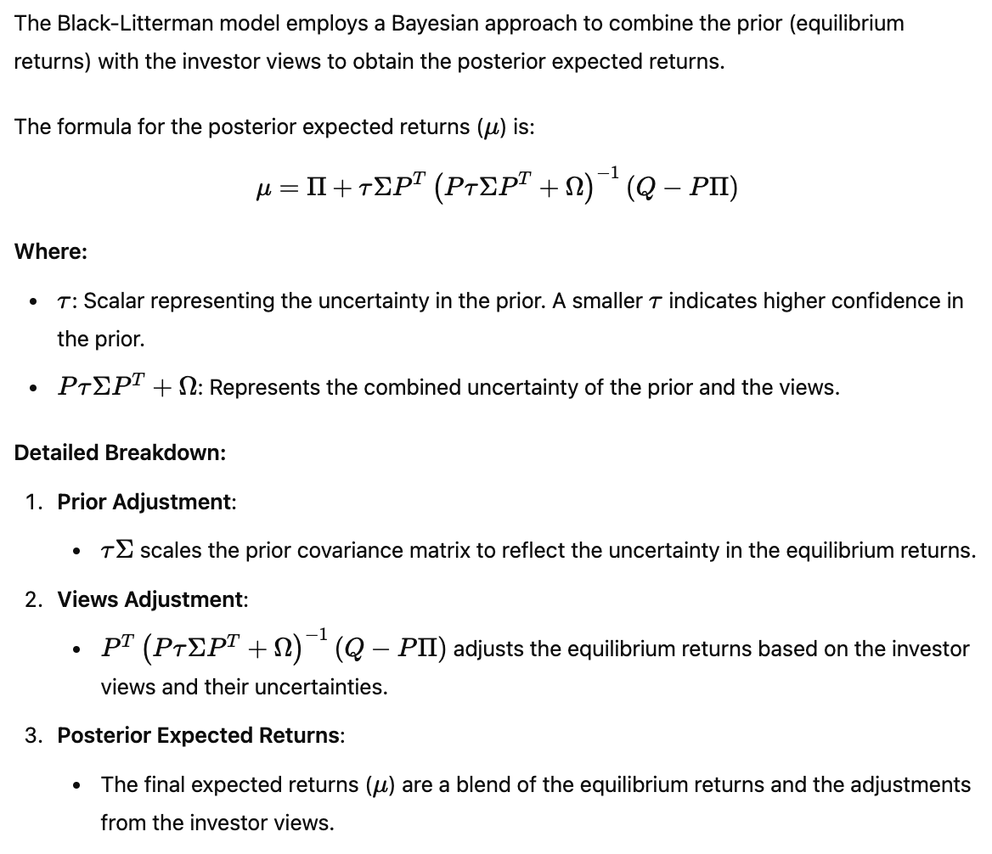
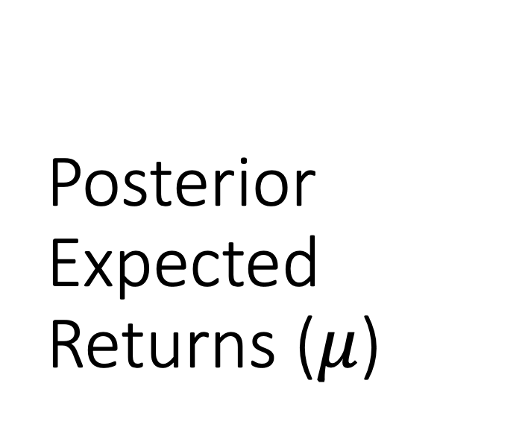
Posterior Expected Returns ($μ$)

Slide 11
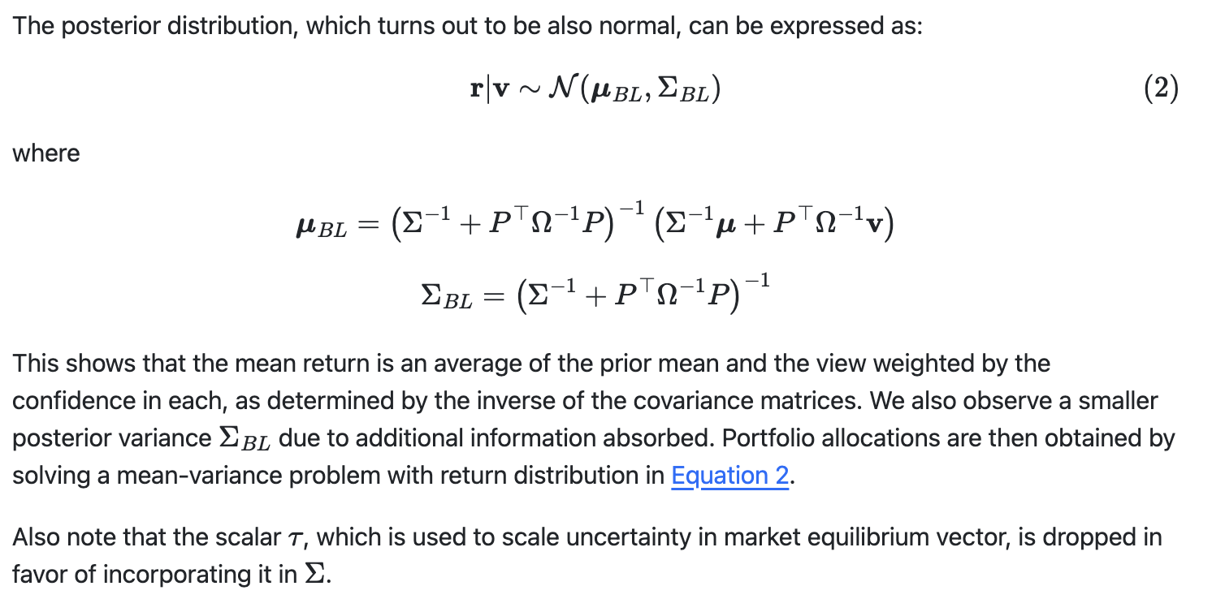



Posterior Return Distribution
prior
data

Slide 12
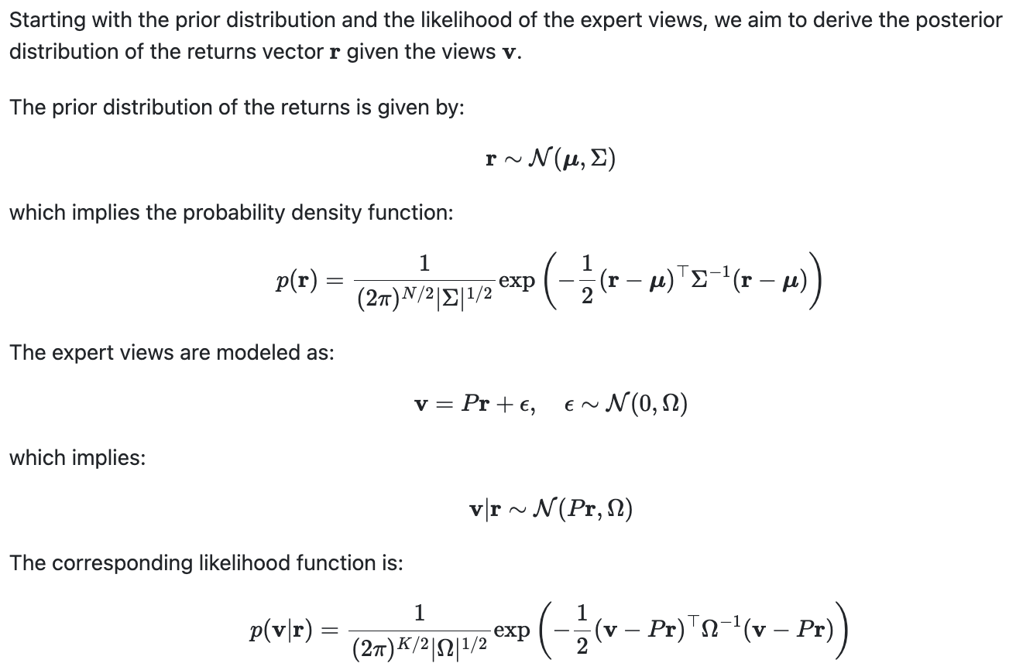
Deriving the Posterior Distribution 1 (optional)
CAPM w*, sigma

Slide 13
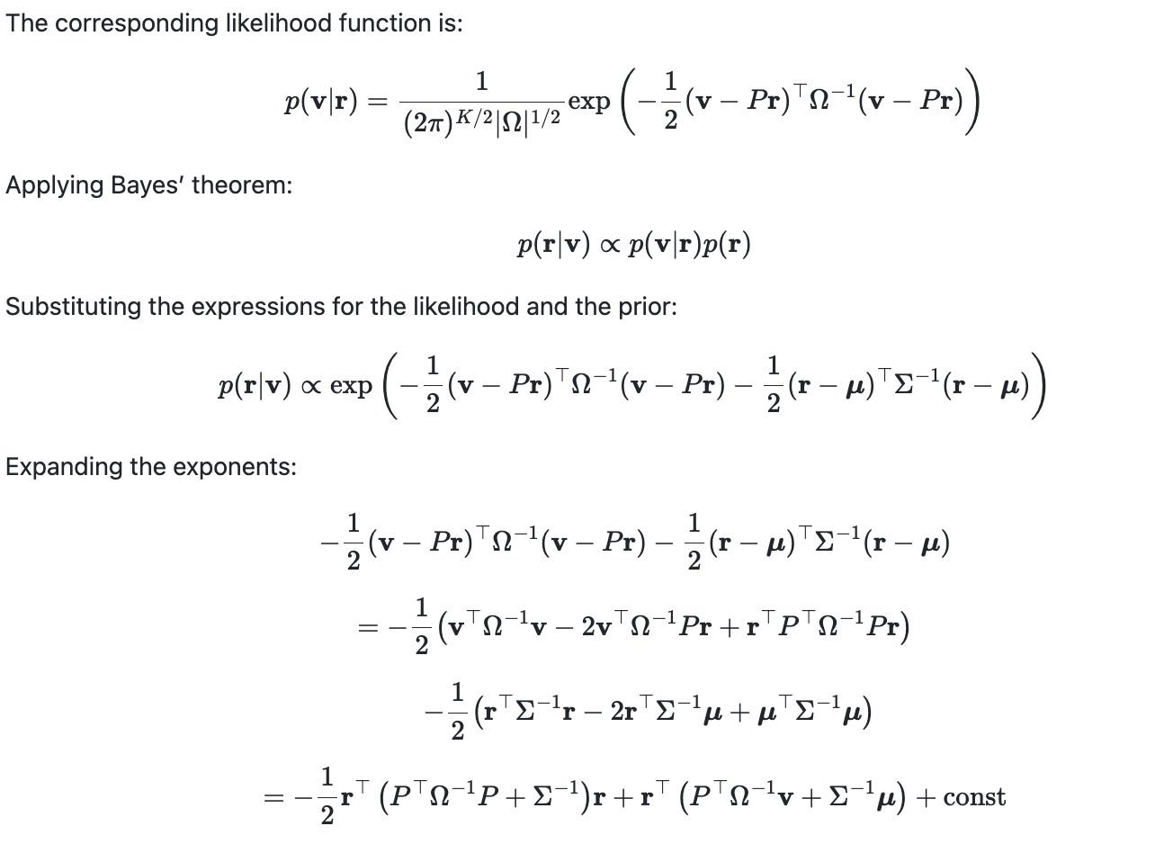
Deriving the Posterior Distribution 2 (optional)

Slide 14
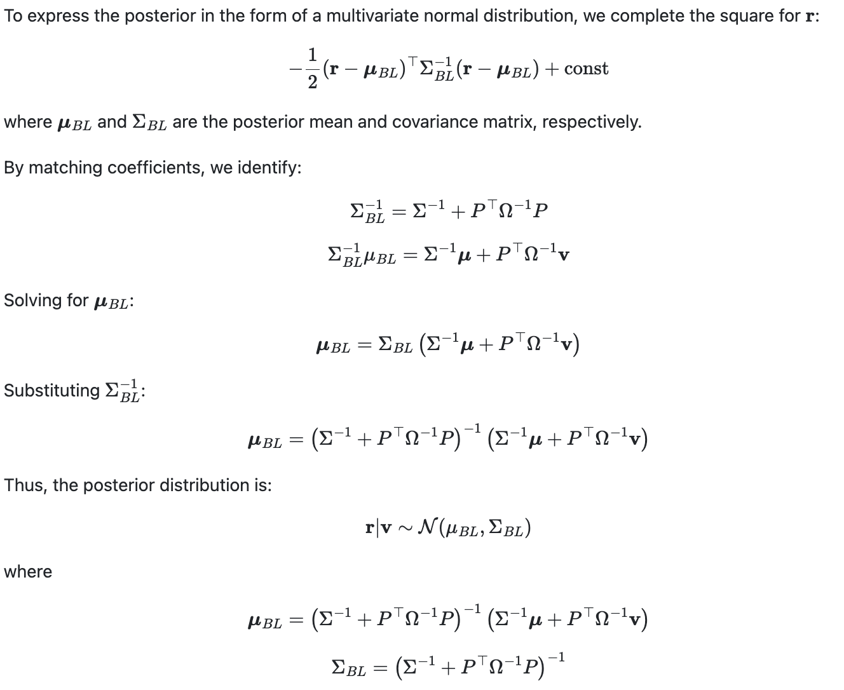
Deriving the Posterior Distribution 3 (optional)

Slide 15
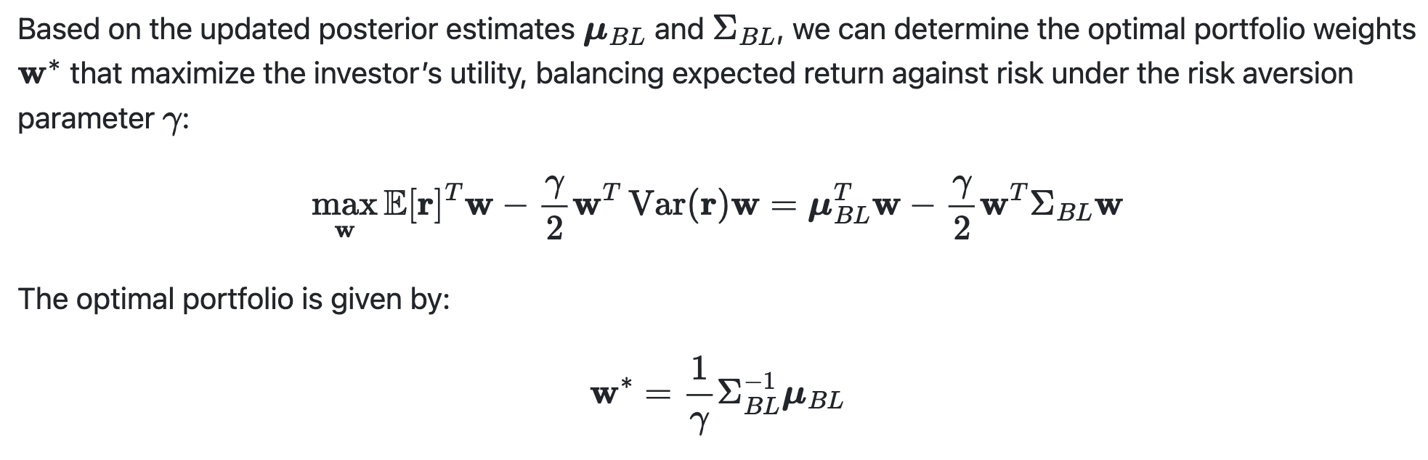
Optimal BL Portfolio

Slide 16
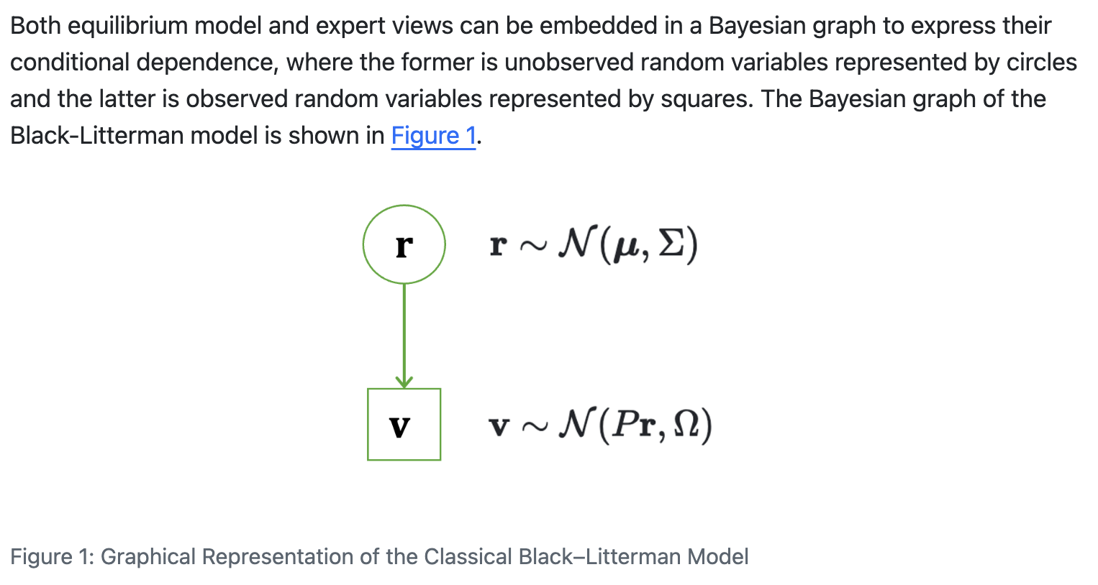


A Graphical Representation

Slide 17
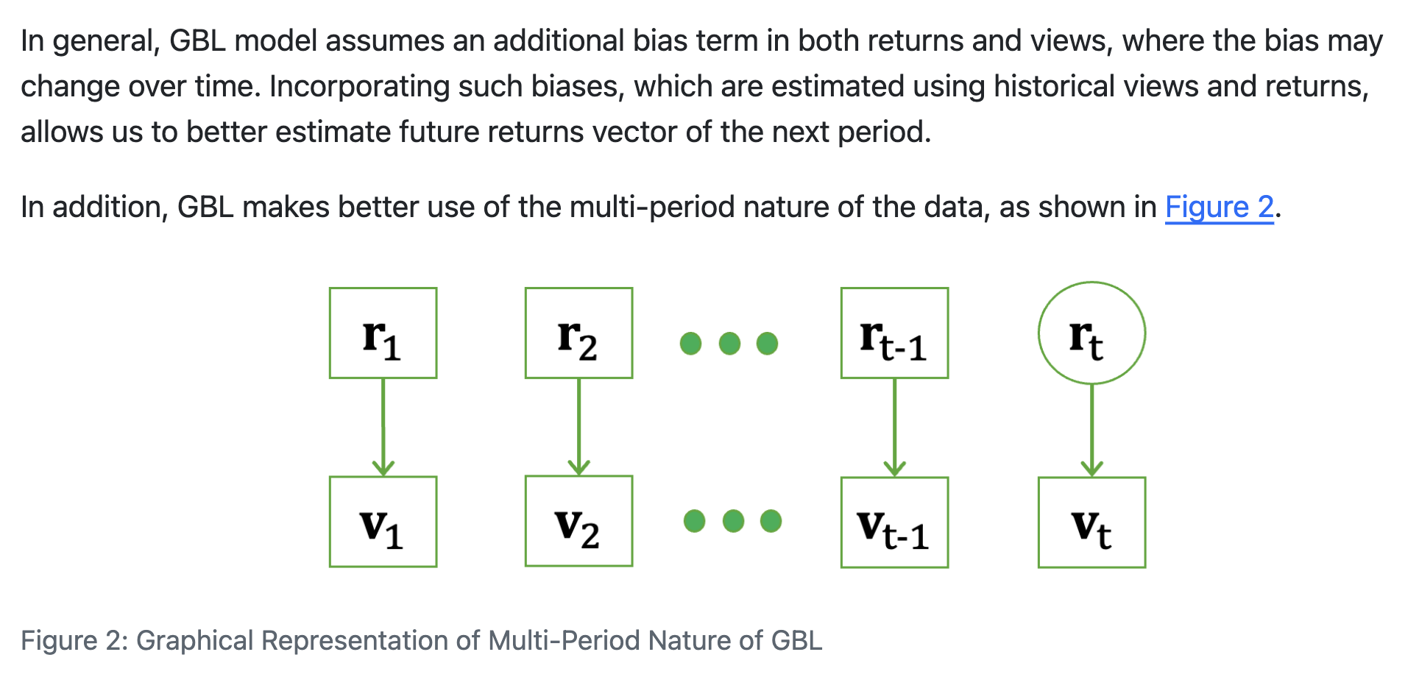
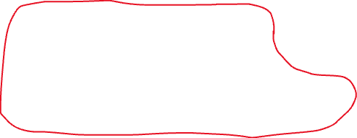

Generalized Black-Litterman Model

Slide 18
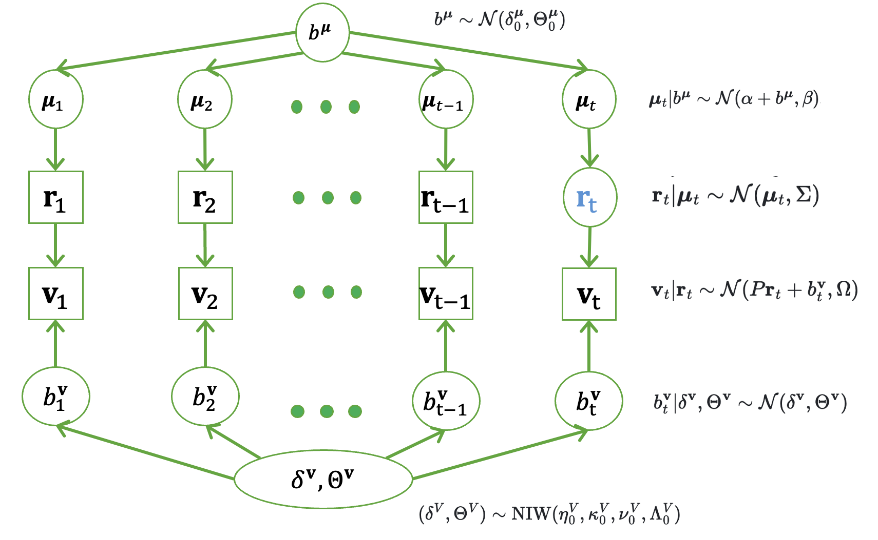
The Full GBL

Slide 19
In-class quiz

